Slide 1

Programma Erasmus+
KA2- Coopération en matière d’innovation et d’échanges de bonnes pratiques
Durée: 3 ans (2016-2019)
Titre du projet
Unissons nos cœurs sans frontières

Slide 2
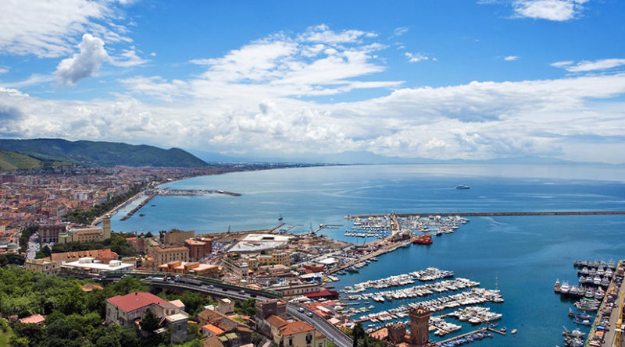
SALERNO ITINERARY
Enjoy Salerno in our itinerary!

Slide 3
Medieval itinerary
- Duomo (Salerno Cathedral)
- Castello Arechi (Arechi Castle)
- Acquedotto medievale (Medieval acqueduct)
- Giardini della minerva (Minerva Gardens)

Slide 4
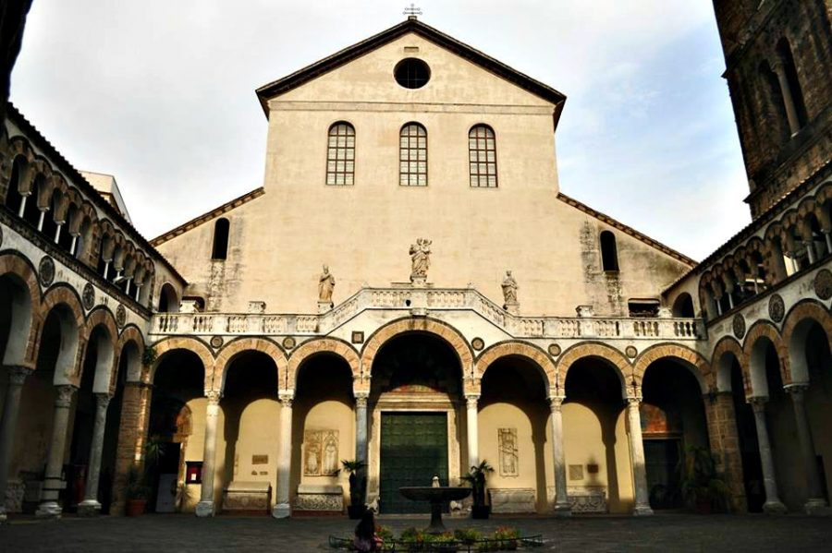
Duomo (Salerno Cathedral)
Salerno cathedral (or Duomo) is the main church in the city of Salerno in southern Italy and a major tourist attraction. It is dedicated to Saint Matthew, whose relics are inside the crypt.
The Cathedral was built when the city was the capital of the principality of Salerno.

Slide 5
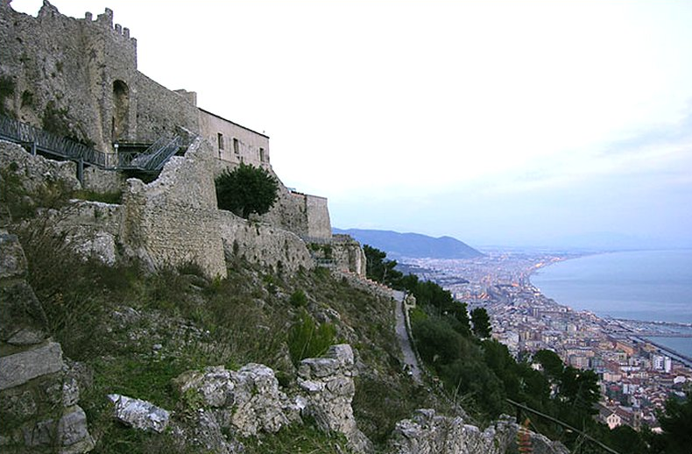
Castello Arechi (Arechi Castle)
The Arechi Castle is a medieval castle, situated at a height of about 300 meters above sea level, overlooking the city and the Gulf of Salerno. It is said Arechi because the construction of this fortification is associated, traditionally, to the Lombard Duke Arechi II.

Slide 6
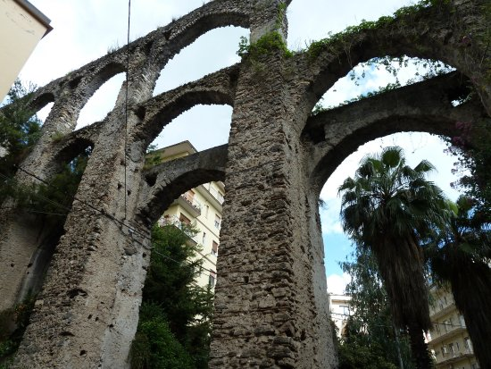
Acquedotto medievale (Medieval acqueduct)
Back in town, just outside the old town, start the real urban itinerary, at via Arce you can begin, this time on foot, the discovery of Salerno's Medieval Acqueduct, popularly renamed "Bridges of the Devil", it is said that it was built in a single night, with the help of demons, by the magician of the twelfth century Pietro Barliario. The popular superstition considered also that venturing under the arches between dusk and dawn would bring to the meeting with devils or evil spirits.

Slide 7
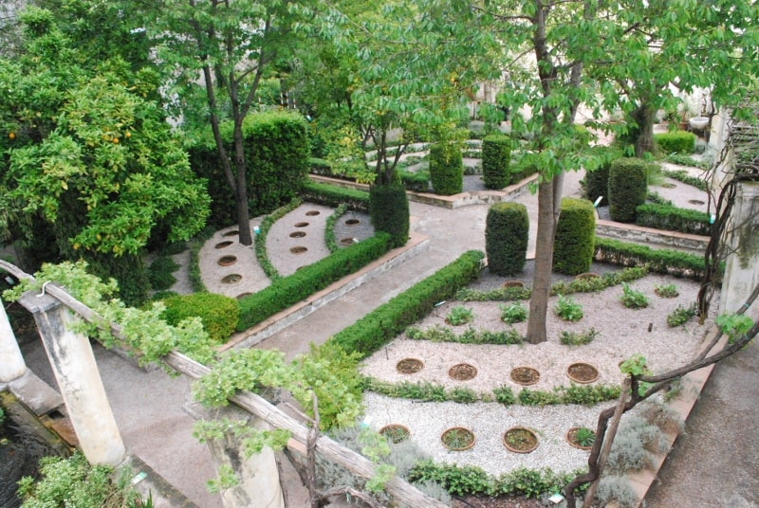
Giardini della minerva (Minerva Gardens)
From here continuing along Via Torquato Tasso you reach the Gardens of Minerva, a magnifique paradise since the twelfth century belonged to the family of Matteo Silvatico, eminent doctor of the Schola Medica, an expert of plants used for the production of medicines.

Slide 8
Contemporary Itinerary
- Municipio (Town Hall)
- Teatro Verdi (Verdi Theatre)
- Lungomare Trieste

Slide 9
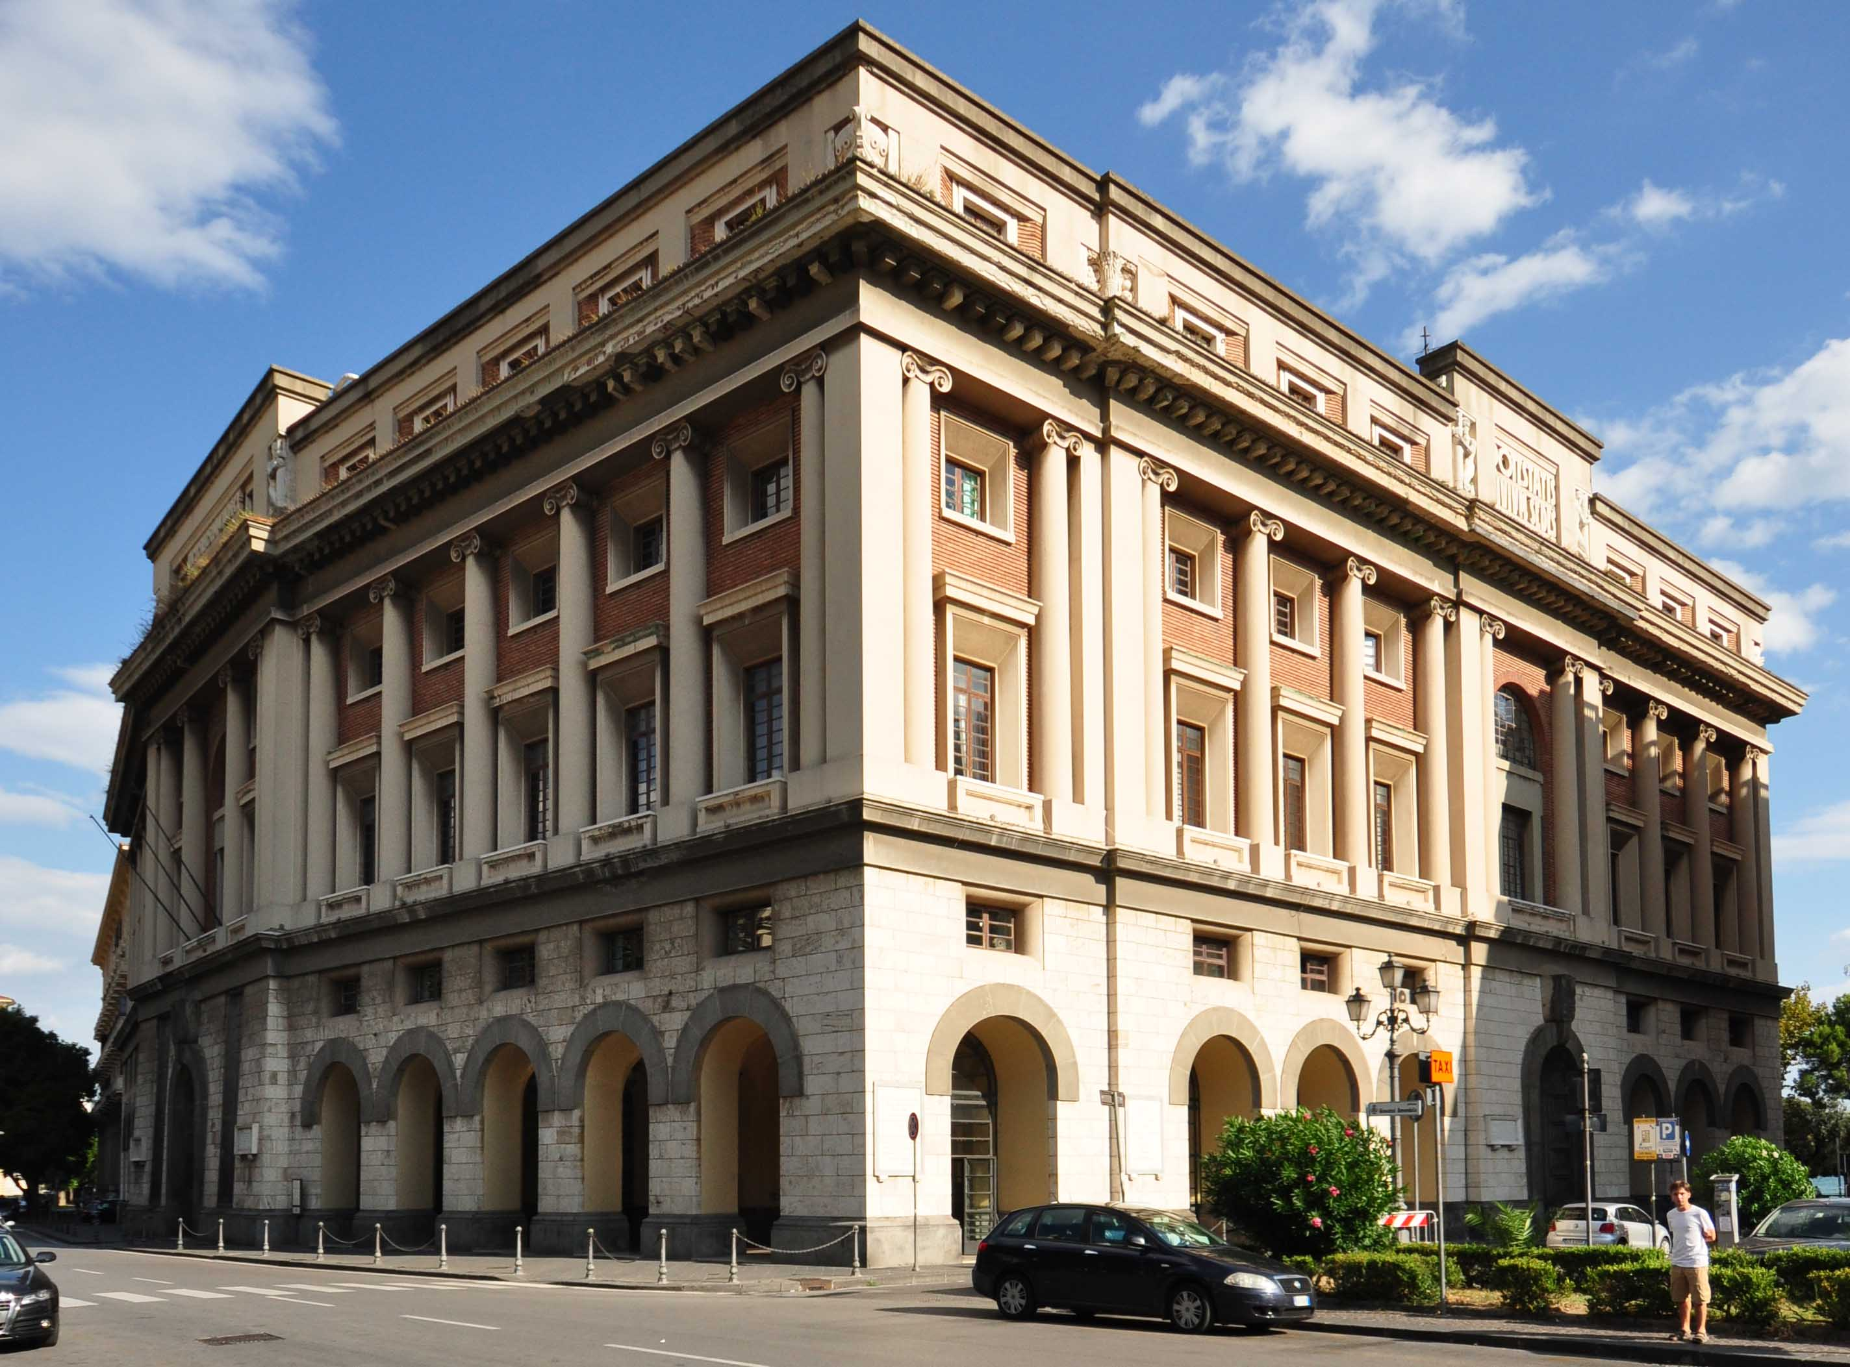
Municipio (Town Hall)
The Town Hall of Salerno was inaugurated in 1936. It stands on an area of about 500 m² and is four levels high, with a porch entrance. The building was designed by architect Camillo Guerra and has an architecture in typical fascist style.

Slide 10
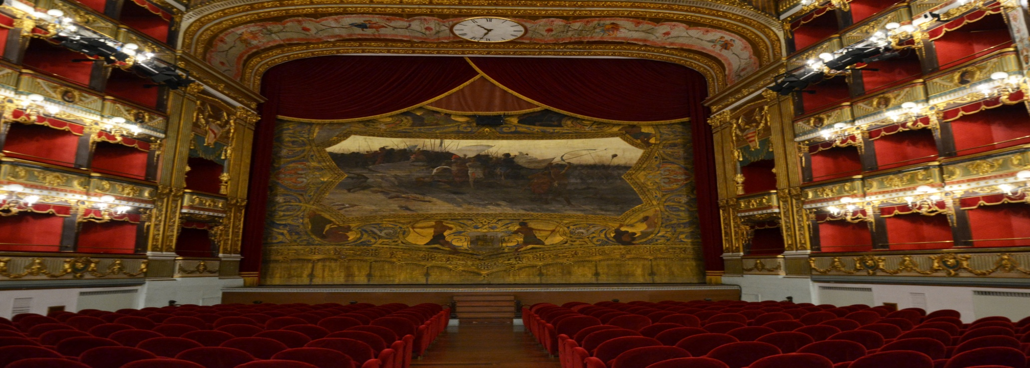
Teatro Verdi (Verdi Theater)
The construction of the Teatro Municipale Giuseppe Verdi was approved by the City Council of Salerno on December 15, 1863 on a proposal of the then Mayor Matteo Luciani.
The design and direction of the works were assigned to the architects Antonio D'Amora and Giuseppe Manichini. The works of decoration were instead directed by Gaetano D'Agostino. The March 27, 1901 the theater was named after Giuseppe Verdi, who died January 1st of that year.

Slide 11
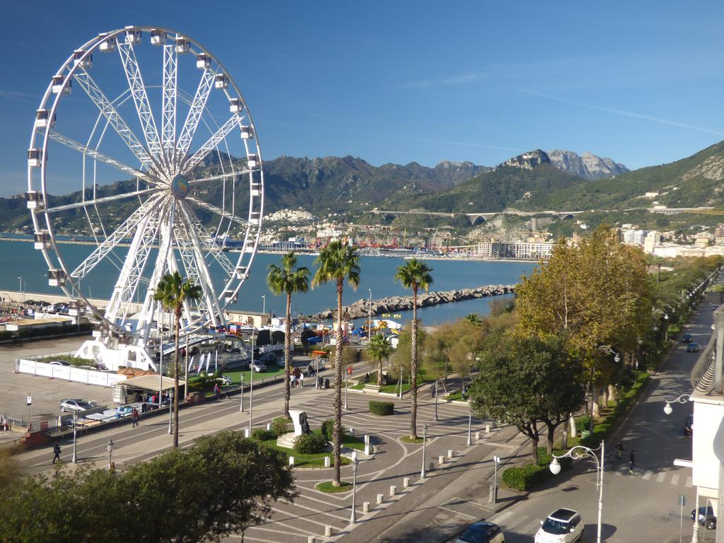
Lungomare Trieste
The Lungomare Trieste of Salerno is one of the landmarks of the city. A pedestrian walk directly on the beach, divided across multiple lanes and 2 km long, from the old town centre to the tourist harbor of Piazza della Concordia. The promenade comes alive during the spring holidays with entertainment activities for the little ones, with the traditional puppet theater, flea markets and fairs.

Slide 12
Modern itinerary
- Spiaggia di Santa Teresa
- Marina d‘Arechi
- Stazione marittima

Slide 13
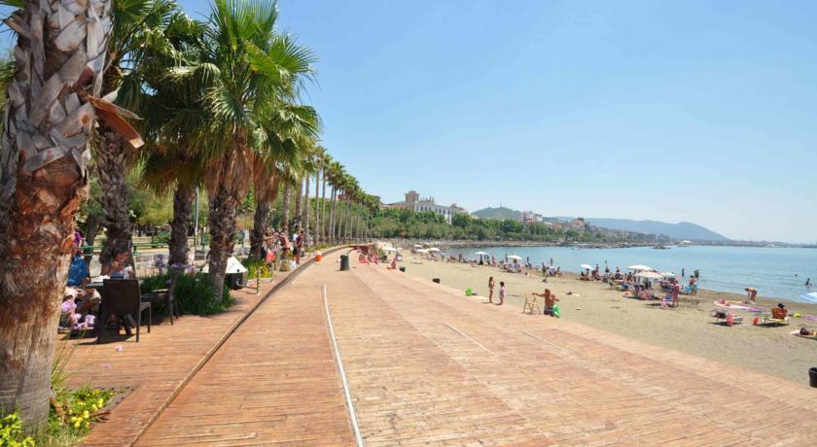
Spiaggia di Santa Teresa (Saint Theresa beach)
This beach is much loved both by people from Salerno, and by visitors, who enjoy sitting there, basking in the sunshine.

Slide 14
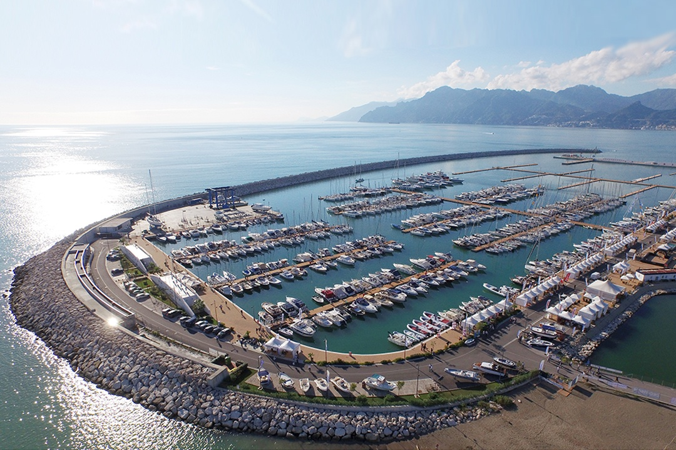
Marina d’Arechi
The marina d’arechi is a port-island off the south coast of Salerno, near the Arechi Stadium, desesigned by architect Santiago Calatrava. In 2008 the Gallozzi Group commissioned the architect Santiamo Calatrava to design a nautical club and bridge connecting the Marina and the mainland. The suspended cable is about 105 meters long and 10 meters wide. The bridge is maintained by a network of 16 suspended cables connected to a 100 meters high steel pylon.

Slide 15
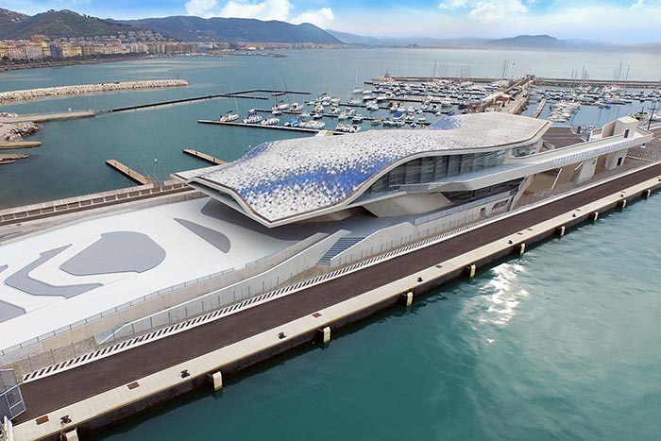
Stazione marittima (salerno harbor station)
The Salerno Harbour station is maritime station located on the pier of the commercial port of the city of Salerno, and is directly linked with the costruenda Freedom Square and the city's waterfront .
In 2013 the Ministry of cultural heritage and cultural and tourism activities has entered the maritime station in the selected group of high-quality architectural interventions.

Slide 16
Have a good travel!

