Slide 1
a.s. 2018-2019
Programma Erasmus+
KA2- Coopération en matière d’innovation et d’échanges de bonnes pratiques
Durée: 3 ans (2016-2017-2018)
Titre du projet
Unissons nos cœurs sans frontières
Let’s unite our hearts without borders

Slide 2
HUMAN RIGHTS

Slide 3
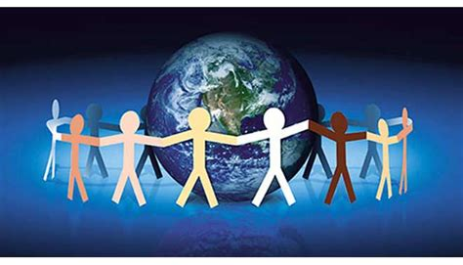
What are your human rights?
Human rights are rights inherent to all human beings, whatever our nationality, place of residence, sex, national or ethnic origin, colour, religion, language, or any other status. We are all equally entitled to our human rights without discrimination.

Slide 4
The Age of Codification
On July 4th, 1776, the representatives of the 13 colonies met in Philadelphia and signed the Declaration of Independence, decreeing the birth of the United States of America. The Declaration, written by Thomas Jefferson followed the principles of the Enlightenment:
He affirmed the equality of all American citizens
He affirmed the right of every citizen to freedom and happiness

Slide 5
La Déclaration des droits de l'homme et du citoyen est un texte fondamental de la Révolution francaise, qui énonce un ensemble de naturels individuels et les conditions de leur mise en œuvre. Ses derniers articles sont adoptés le 26 /08/1789.

Slide 6
Universal Declaration of Human Rights
Formally adopted by the United Nations on December 10th, 1948, it is the most universal human rights document in existence, delineating the thirty fundamental rights that form the basis for a democratic society.

Slide 7
Universal Declaration of Human Rights
In its preamble and in Article 1, the Declaration unequivocally proclaims the inherent rights of all human beings:
“……All human beings are born free and equal in dignity and rights.”

Slide 8
Is the Declaration of Human Rights still more a dream than a reality?
Human rights exist, they are recognized by most nations and form the heart of many national constitutions.
Yet the actual situation in the world is far distant from the ideals envisioned in the Declaration.
Women and children in particular are marginalized in numerous ways

Slide 9
Women’s rights
Human rights are important, particularly the situation of women.
The situation of women is particularly alarming in Islamist countries such as Turkey.

Slide 10
The Status of Women in Islam
Islamic civilization considers women to be a lesser class, submissive to men. In some countries of c Islamic culture, there is not a profound level of discrimination, such as in Tunisia, where women are free to dress as they want and have obtained many rights.

Slide 11
In other countries the level of discrimination is much stronger: in Algeria women are raped and killed by Fundamentalist Muslims; in Afghanistan women are "buried" in a burqa, a dress that does not leave even glimpse of the eyes.

Slide 12
In the Taliban countries women are considered to be completely subservient, used to satisfy the sexual needs of men and to take care of the home and children; according to some verses of the Koran - like: "yours women are like a seed to cultivate and so you can do what you want "(2: 223) - men have absolute power over women and they are deprived of all rights.

Slide 13
Western Women
Today the condition of the western woman has clearly improved compared to the past. Women have obtained significant results, gaining independence and work experience.

Slide 14
In any case, even in the most prestigious places, women remain in the minority on the social scale, suffering more than males from the economic crisis and unemployment.

Slide 15
Even if gender equality is officially established by numerous laws, the balance between the sexes has not yet been reached: often the work of the woman out of the family setting results in a double exploitation, inside and outside the home, as the domestic load, and caring for children, the sick, and the old, continues to weigh on their shoulders.

Slide 16
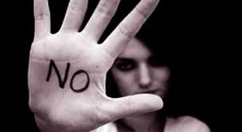
Even today, in our highly civilized society, ruthless forms of marginalization of women, sometimes result in rape and other violence.

Slide 17
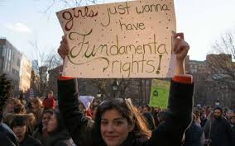
How can we stop this?... we like to remember those women who are still engaged in the struggle of civil rights and women's rights ... Let us be inspired:

Slide 18
Malala Yousafzai
Winner of a Nobel Peace Prize, Malala is a Pakistani activist known for her commitment to the affirmation of civil rights and the right to education of women

Slide 19
Aung San Suu Ky
She is a Burmese politician, active for many years in the defense of human rights and awarded the Nobel Peace Prize in 1991. For her struggle she renounced both freedom and her family.

Slide 20
Shirin Ebadi
She is an Iranian lawyer and pacifist and on December 10th, 2003 she was awarded the Nobel Peace Prize: she was the first Iranian and the first Muslim woman to get this recognition

Slide 21
Tawakkul Karman
She is a Yemeni political and activist, member of the Al-Islah party (Yemeni Congregation for Reformation, the Yemeni branch of the Muslim Brotherhood) and leader since 2005 of the movement “Women Journalists Without chains”, a humanitarian group created by her. As mentioned above, she won the Nobel Peace Prize in 2011.

Slide 22
And finally we would like to remember the words of Pope John Paul II according to whom..
"Where there is no respect for human rights - I mean the inalienable rights inherent in man as a man - there can be no peace, because any violation of personal dignity favors resentment and the spirit of revenge.“

