Slide 1
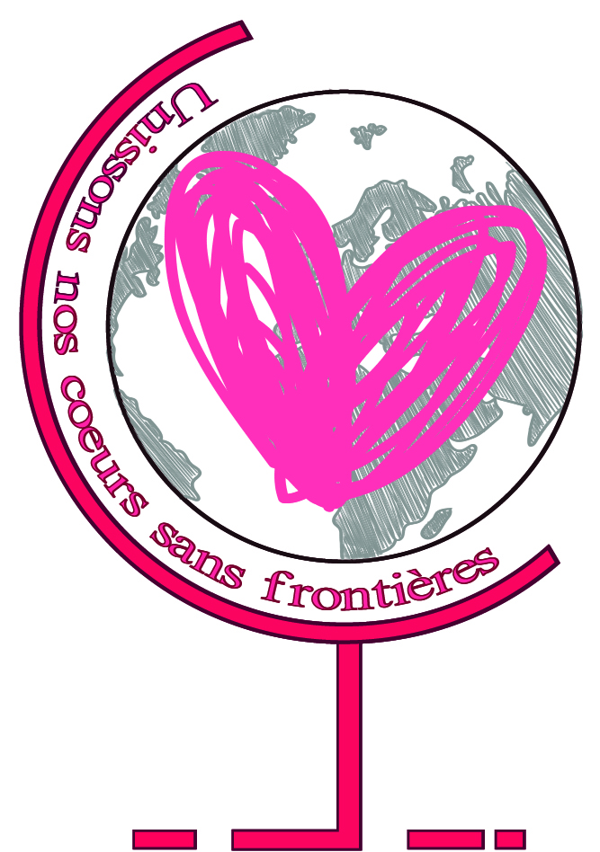
Programma Erasmus+
KA2- Coopération en matière d’innovation et d’échanges de bonnes pratiques
Durée: 3 ans (2016-2019)
Titre du projet
Unissons nos cœurs sans frontières

Slide 2
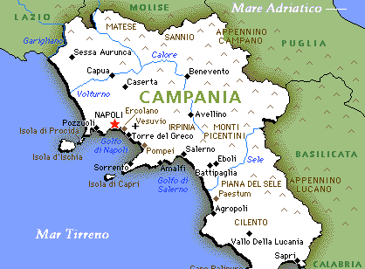
Welcome to Campania

Slide 3
Campania is a region situated in the South of Italy. The mountains calcaree created many gulfs and beautiful peninsules, like Sorrento. Campania is located among four gulfs,such as; Gaeta, Naples, Salerno and Policastro.The isles, located in the gulf of Naples,are: Nisida, Procida, Vivara, Ischia, Capri and Li Galli. The territory is dominated by an inactive vulcan: Vesuvio.
Territory

Slide 4
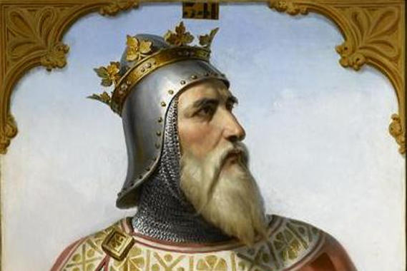
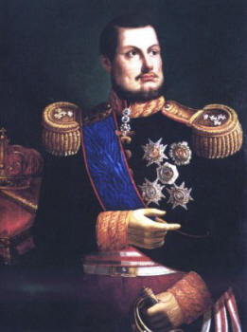
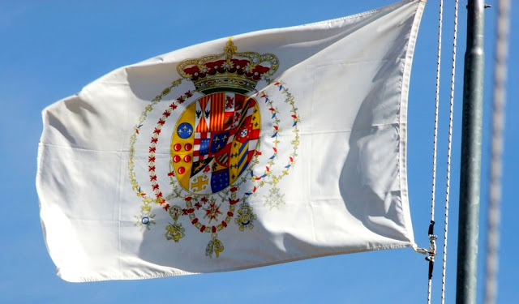
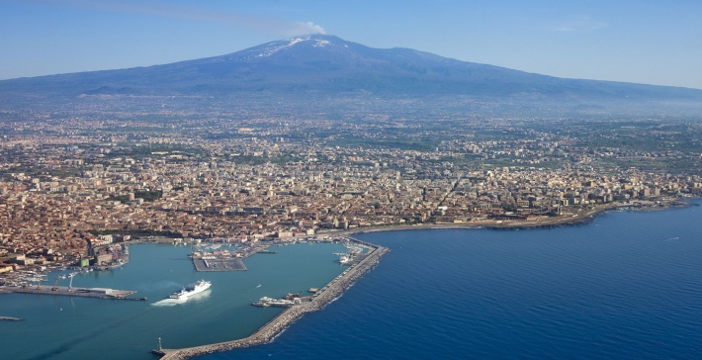
History
In VI century, Romans invaded the territory and they called it: Campania. Robert the Guiscard created their Kingdom for these region, in south of Italy and in Sicilia. With Federic II, Campania had the best culture and economic period. Aragonese’s dinesty founded the Two Sicilie’s kingdom, later they passed to the Spanish Borbons. In 1860 the Naples’s kingdom was annexed to Italy.

Slide 5
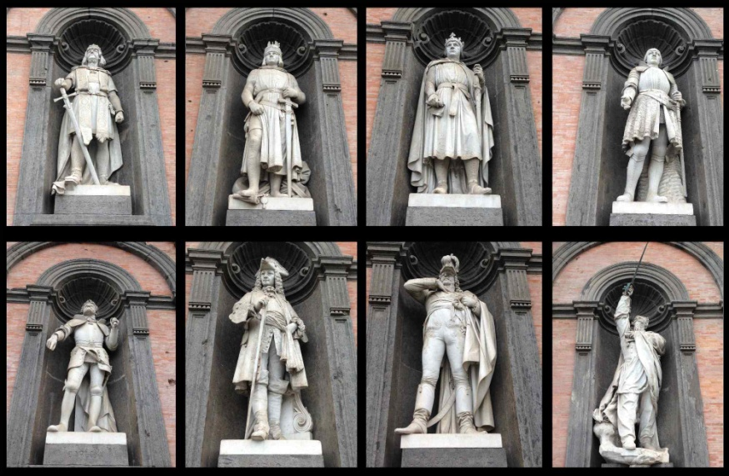
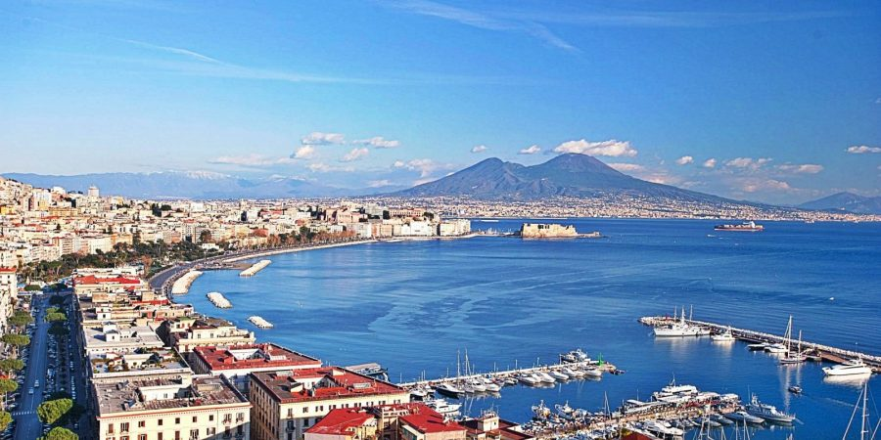
The city of Naples (Neapolis) was founded by Greek’s colons. The Plebiscite’s Square is the most important square in Naples. There are a lot of important statues,like:Ferdinand of Borbons and Charles III. Royal palace had a beautiful red façade with 8 statues (8 Naple’s dynastie). The national archeology museum of Naples is the biggest in the world. Saint Carlo Theatre is the second theatre of Italy in Neoclassic style. Ovo’s castle was the royal residence of Norman.
Naples

Slide 6
Located in the shadow of Mount Vesuvius, Herculaneum (Italian: Ercolano) was an ancient Roman town destroyed by volcanic pyroclastic flows in 79 AD. Its ruins are located in the comune of Ercolano, Campania, Italy. Herculaneum was a wealthier town than Pompeii, possessing an extraordinary density of fine houses with, for example, far more lavish use of colored marble cladding.
Located in the shadow of Mount Vesuvius, Herculaneum (Italian: Ercolano) was an ancient Roman town destroyed by volcanic pyroclastic flows in 79 AD. Its ruins are located in the comune of Ercolano, Campania, Italy. Herculaneum was a wealthier town than Pompeii, possessing an extraordinary density of fine houses with, for example, far more lavish use of colored marble cladding.

Slide 7
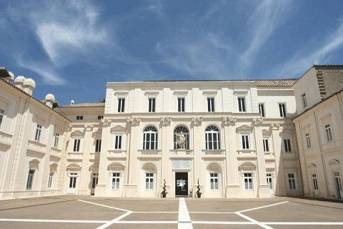
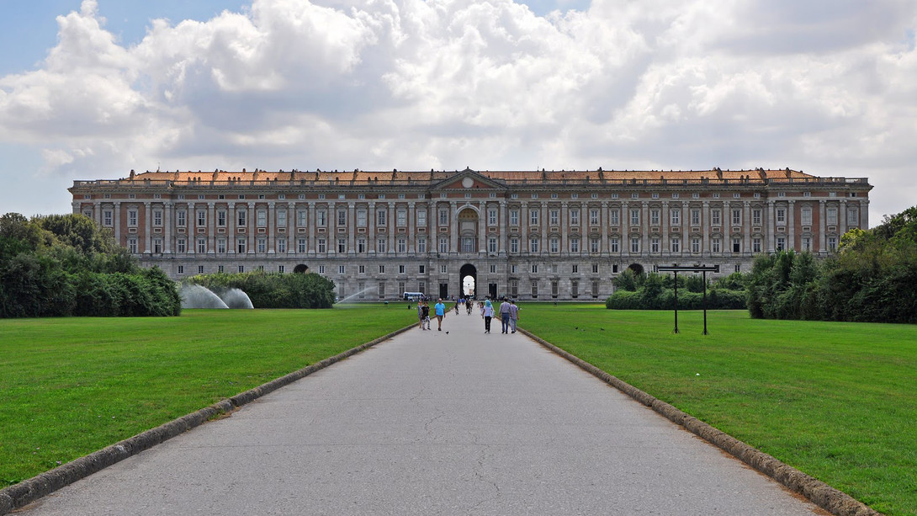
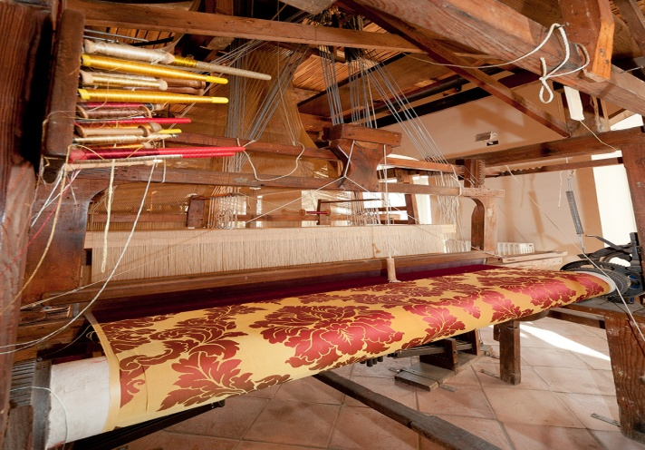
Caserta takes this name from the royal palace. In 1752 Charles III decided to have a palace. It was compete in the XVI century. There are many principal entrance. St. Leucio is important because there it was born the first silk’s factory.

Slide 8
Amalfi
Amalfi is located on the southern coast of Sorrento peninsula. It included Sorrento city, Vietri sul mare ( known for terracotta) Cetara, Maiori, Tramonti, Minori and Ravello. It also has the beautiful panorama with villa Rufolo and villa Cimbron. Amalfi was the most important maritime republic for the king of Naples.

Slide 9
Paestum (Poseidonia) was built in 600 A.C by the Greek and,later,by the romans. In XVIII A.C. The archealogist found 3 templs: Hera themples, Nectune themples ( preserved better than 3 themples) and Cerrer themple (it is the smallest by other) and it was dedicated to the goddess Athena.

